Slide 1
Damping Constant Optimization for Landing Gear Stability using Cosserat Rods
ME 447 Project 3
Chao-Huai Tsao
Kai-Wen Yang

Slide 2
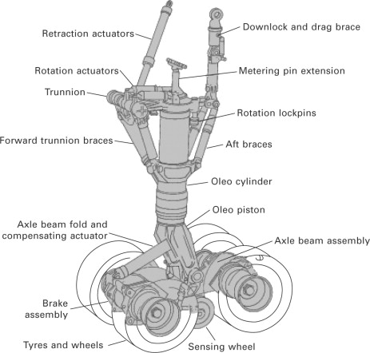
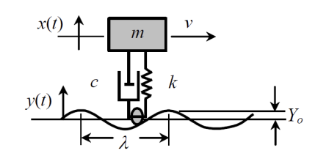
Project 3 – Landing Gear of Aircrafts Introduction
In this project, we simulated the length change response of the landing gear by Cosserat Rod Theory. The landing gear system can be modeled as spring-mass-damper system as Fig.2.
In this simulation, we considered the landing gear structure as a cosserat rod and used mass-spring-damper system to calculate damping constant.
Our purpose is to find the best damping constant of the landing gear system, making the system be stable as faster as it can.
Fig. 1
Fig. 2

Slide 3
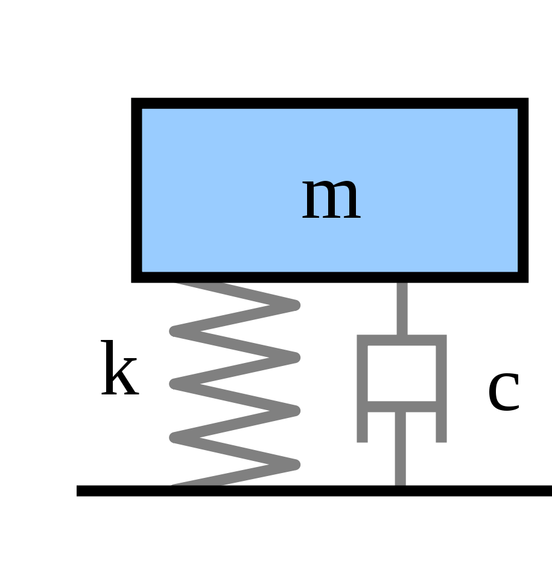
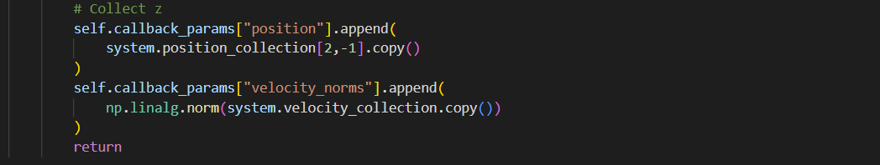
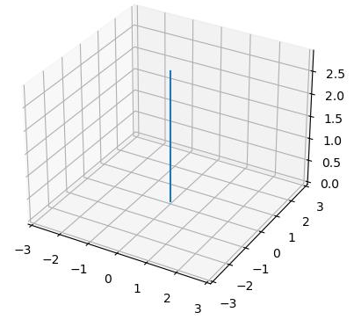
Strategy
According to the reference [1], the damping constant will be 0.13595.
As we considered the structure as cosserat rod, we can refer to the example, axial stretching, in the Github. The direction along the z-axis ([0,0,1]), so we must collect z data as following:
We considered the system is axial compression.
For Boundary condition, we assumed the system is OneEndFixed BC and the nodal force was applied on the last node of the rod. The end_force is 5000 N along to the –z direction.
m: aircraft mass: 5000N
k : elastic constant (young’s modulus) :4e6 Pa
c: damping coefficient
Cosserat Rod Model: (Length =3)

Slide 4
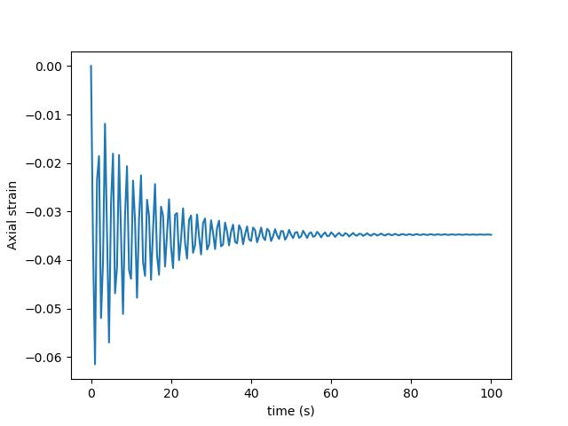
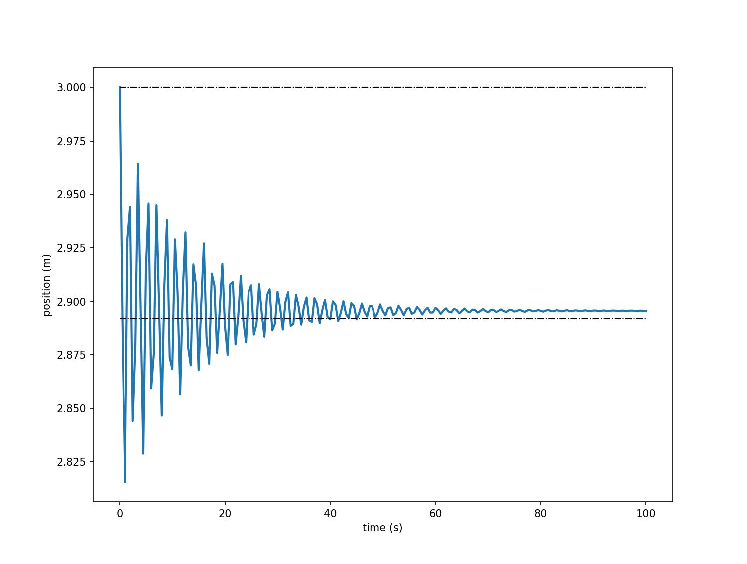
Results
According to above figures, we can find out that the original length is 3(m), during the landing process, after the force acted on the ROD, the length oscillated between 2.825 and 3 meters and tended to a stable value of about 2.9 meters. The stable time is about 60 seconds.

Slide 5
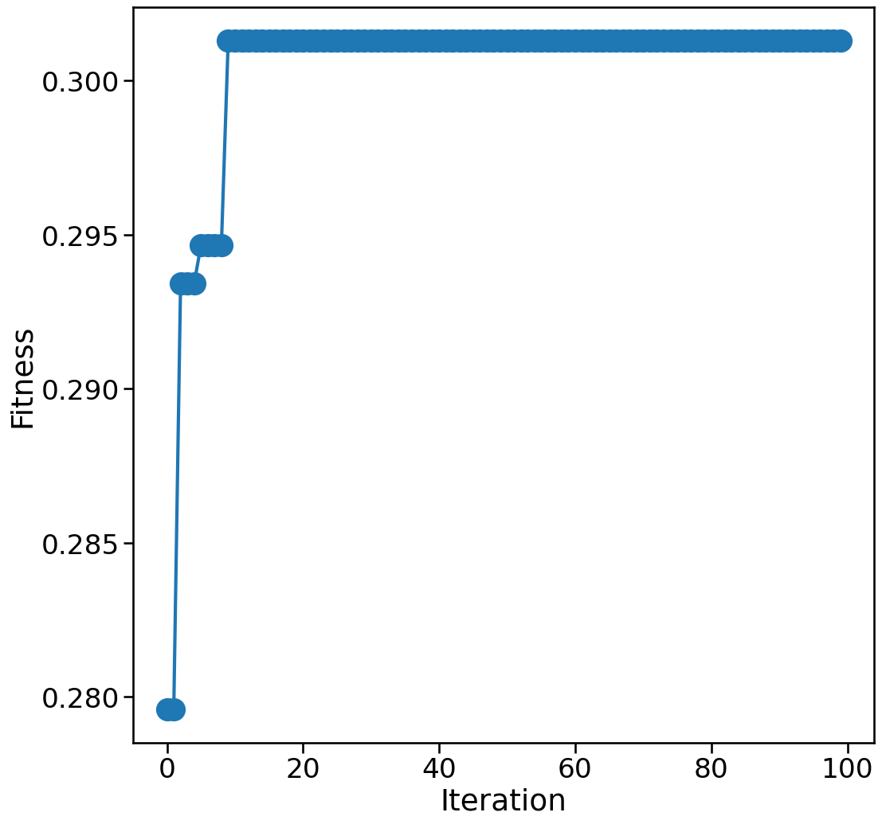

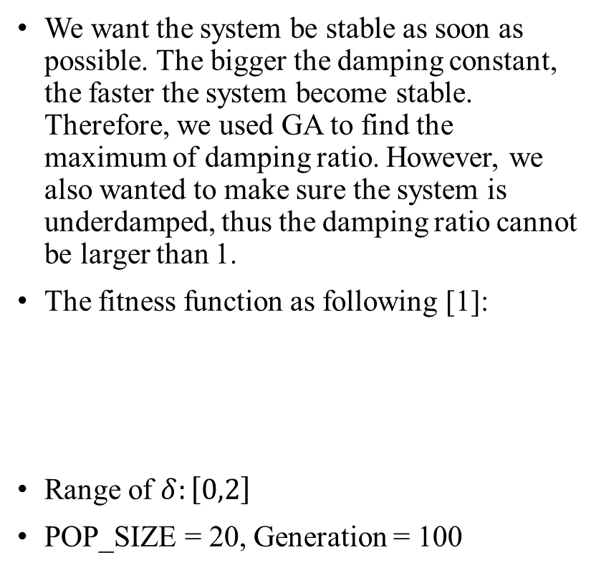
GA- Landing Gear of Aircrafts
We want the system be stable as soon as possible. The bigger the damping constant, the faster the system become stable. Therefore, we used GA to find the maximum of damping ratio. However, we also wanted to make sure the system is underdamped, thus the damping ratio cannot be larger than 1.
The fitness function as following [1]:
Range of $δ:\left[0,2\right]$
POP_SIZE = 20, Generation = 100
The optimization stabilize after 20 iterations (total generations: 100)
The best fitness is about 0.3

Slide 6
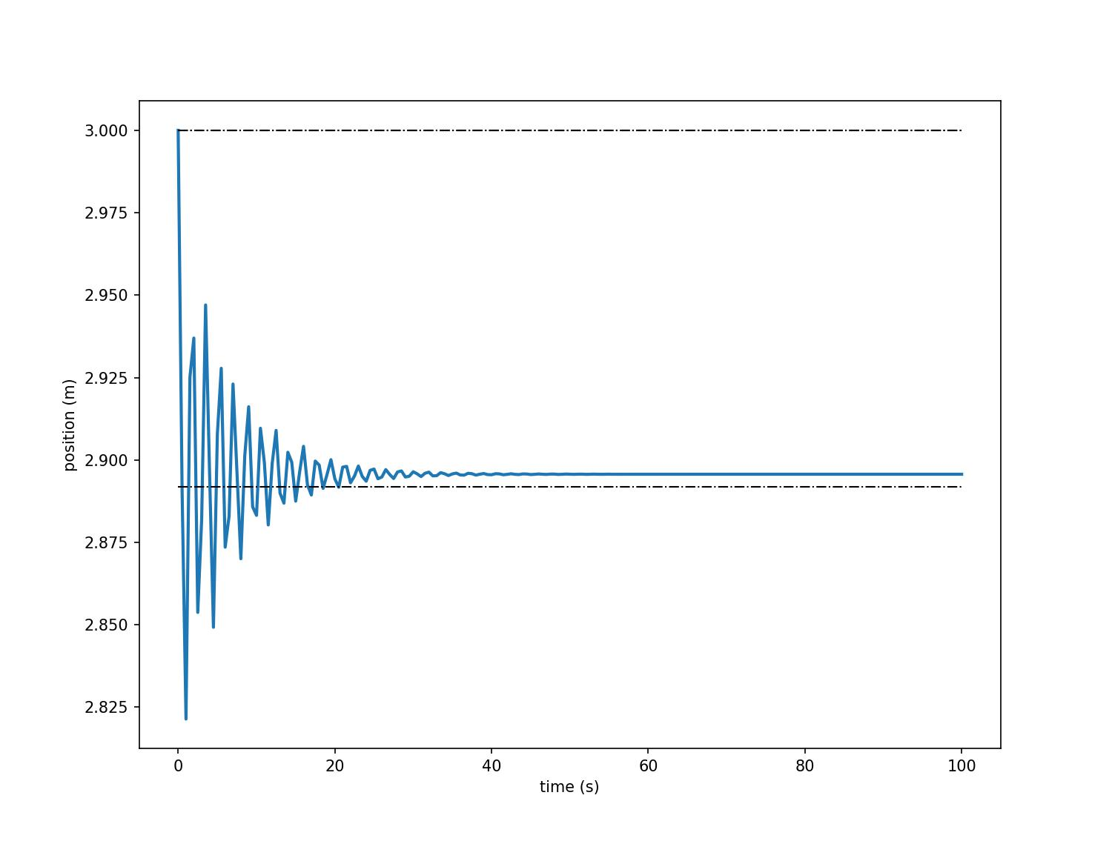
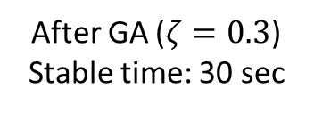
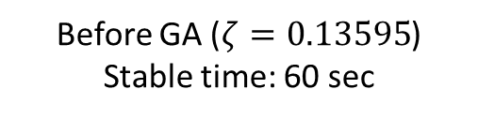
Comparison
Before GA ($ζ=0.13595$)
Stable time: 60 sec
After GA ($ζ=0.3$)
Stable time: 30 sec
From the above pictures, after optimizing the damping constant, the stable time is shorter than before. Therefore, $ζ=0.3$ is an optimal solution. For shorter stable time, it means that the length of the structure will not always expand and contract and cause metal fatigue

Slide 7
Conclusion & Future Challenge
•In this simulation, we found the best damping constant for the landing gear system of an aircraft, which is around 0.3. Therefore, the structure's length will reach stable after 30 seconds.•In this project, we simplified the landing gear system as a mass-spring-damping system.
If we want to study the movement trajectory of each part of the landing gear, we must use the complete structure, that is, build several cosserat rod models and connect them with joints.

Slide 8
Reference
[1] Pash, G., Sebastian, J. and Johnson, N. (2018) “Analysis of a aircraft landing gear suspension system”, wordpress.ncsu.edu. Available at: https://noahjohnson.wordpress.ncsu.edu/files/2018/11/mae_315__project_1-1.pdf.
[2] https://github.com/GazzolaLab/PyElastica

